Slide 1
Week#01 Introduction To Web Engineering
Course Instructor:
Haris Ahmed
DEPARTMENT OF SOFTWARE ENGINEERING
SIR SYED UNIVERSITY OF ENGINEERING & TECHNOLOGY

Slide 2
WHAT IS THE COURSE ABOUT?
Many applications continue to be developed in an ad-hoc way, contributing to problems of usability, maintainability, quality and reliability.
This course examines systematic, disciplined and quantifiable approaches to developing high- quality, reliable and usable web applications.
The course introduces the methodologies, techniques and tools that support their design, development, evolution, and evaluation.

Slide 3
COURSE GOALS
The goals of the course are as follows:
To be able to analyze and design comprehensive Web application.
To learn and use some of the languages currently used to manipulate information on the World Wide Web – i.e., Java and JavaScript.
To learn techniques and evaluation metrics for ensuring the proper operability, maintenance and security of a web application.

Slide 4
What is World Wide Web?
World Wide Web (WWW) – an application on the Internet that combines many protocols to allow for communication and transfer of data between machines
Web is composed of documents that are logically linked to each other
Originally designed to:
Provide easy access to documents for anyone
Provide way in which users can discover documents through a browser

Slide 5
World Wide Web == Internet?
No! They’re not the same!
The World Wide Web is an application that operates over the Internet
Internet provides infrastructure
World Wide Web utilizes the infrastructure to run an application on which users connect and exchange data
Other applications use the Internet as well, e.g email

Slide 6
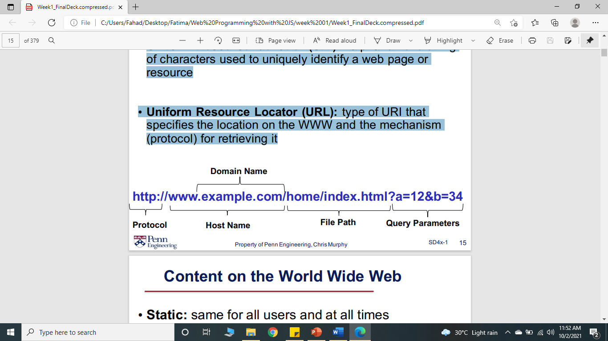
Web Page Addresses
Uniform Resource Identifier (URI): alphanumeric string of characters used to uniquely identify a web page or resource
Uniform Resource Locator (URL): type of URI that specifies the location on the WWW and the mechanism (protocol) for retrieving it

Slide 7
Content on the World Wide Web
Static: same for all users and at all times
Appearance may vary based on specific browser, but content itself is the same
Technologies: HTML, CSS
Dynamic: programmatically generated depending on the user, context, configuration, arguments, etc.
Technologies: JavaScript

Slide 8
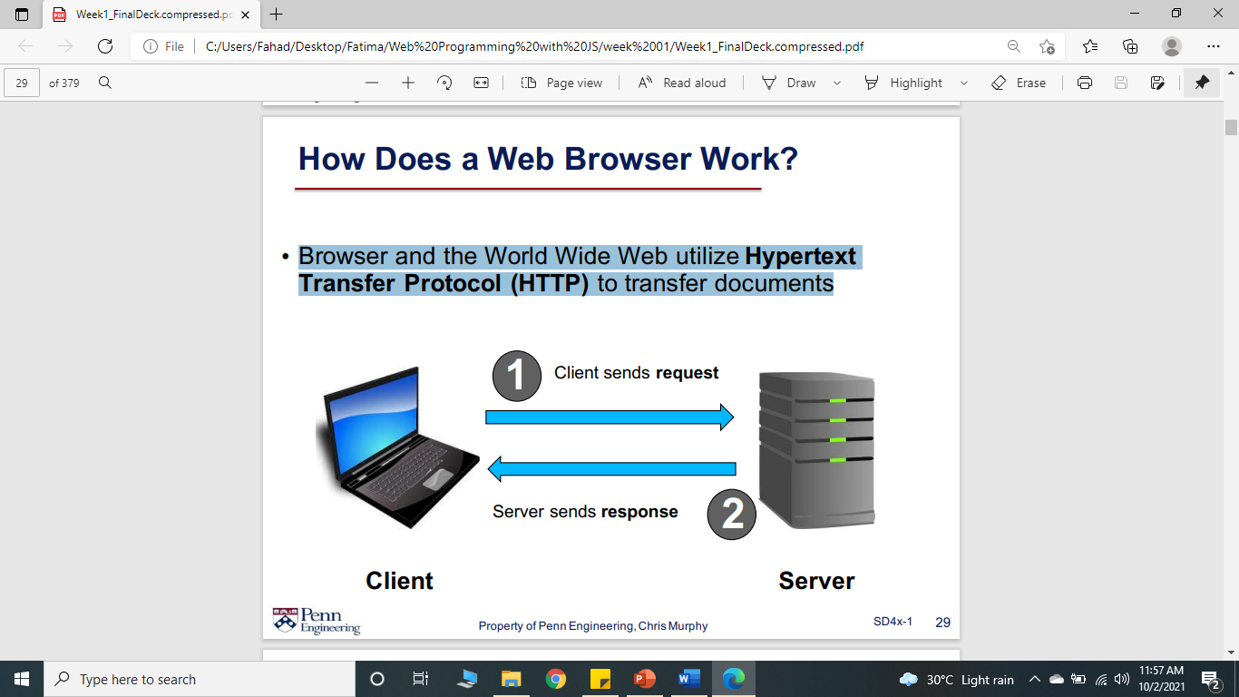
How Does a Web Browser Work?
Browser and the World Wide Web utilize Hypertext Transfer Protocol (HTTP) to transfer documents

Slide 9
Software Engineering
Software Engineering is defined as the application of science and mathematics by which the capabilities of computer equipment are made useful to man via computer programs, procedures, and associated documentation (Boehm 1976)
Software Engineering is the science and art of building significant software systems that are:
On time
On budget
With acceptable performance

Slide 10
What is Web Engineering?
The application of systematic and quantifiable approaches to cost-effective analysis, design, implementation, testing, operation, and maintenance of high-quality Web applications.” – Kappel et al.
Web Engineering is a process that is used to create high quality web apps.
Good content
Well-constructed pages
Security
Search Engine Optimize
Attempting visuals…….. etc

Slide 11
The Case for Web Engineering I
Ten thousand people (approximately) in 12 European countries participated in an MSN online poll to present their opinions about Internet’s future. The reports are as follows:
1. 45% respondents were worried about lack of online privacy;
2. 60% said that they were concerned about business tracking everything on net;
3. 52% predicted that cybercrime will continue to increase;
4. 46% said that the world will become Internet-centric; and
5. 33% said that in the next 9 years or so, all books, magazines, newspapers would disappear as the material would be available online on Web sites.
Notes:
Bank Website

Slide 12
The Case for Web Engineering II
Top project pitfalls (Cutter, 2000)
84% - Failure to meet business objectives
79% - Project schedule delays
63% - Budget overrun
53% - Lack of functionality
52% - Poor-quality deliverables
So, now, a new form of crisis has appeared, i.e., Web crisis.
Please note that due to the omnipresence of Web applications and their complexity, this Web crisis could be more serious. And the challenge of Web engineering is to address all such issues. Also, note that Web engineering must also follow software development life cycle (SDLC) just as we have traditional, conventional software engineering. According to Dart, many organizations are heading towards a Web crisis, as they are not able to keep the system updated. The proliferation involves the ‘quickly hacked together’ systems that are kept without any systematic approaches.

Slide 13
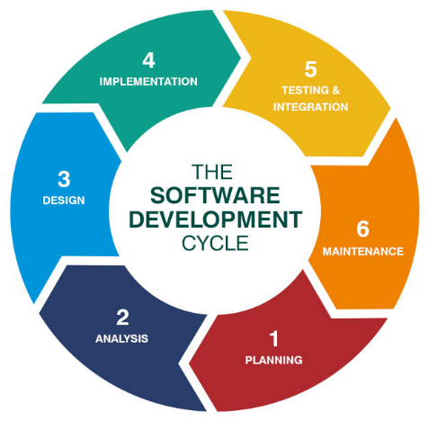
SDLC for Web Applications
Software Development Life Cycle (SDLC) for Web Applications is a structured process used to plan, design, develop, test, deploy, and maintain web-based systems in a systematic and controlled way.

Slide 14
SDLC for Web Applications
Main Phases of SDLC for Web Applications
Requirement Analysis Understanding the purpose of the web application, target users, features, and security needs.
Planning Defining project scope, timeline, budget, and selecting technologies.
Design Creating system architecture, database design, and user interface (UI/UX).
Development Writing frontend and backend code and integrating the database.
Testing Checking for bugs, security vulnerabilities, performance issues, and browser compatibility.
Deployment Making the web application live on a server so users can access it.
Maintenance Continuously updating, fixing, and improving the system after launch.

Slide 15
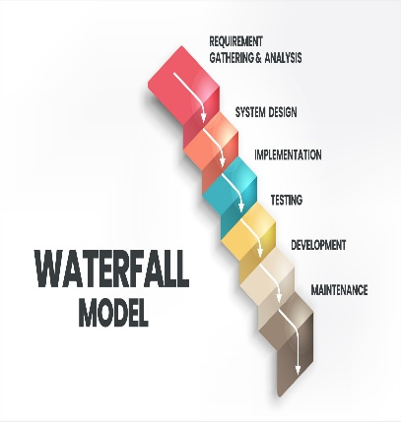
Waterfall model IN WEB ENG
Waterfall Model is a linear and sequential SDLC model in which each phase must be completed before moving to the next one.
Advantages:
Easy to understand and manage
Clear structure and documentation
Suitable for small or well-defined projects
Disadvantages:
Not flexible for changing requirements
Late testing phase
Not ideal for dynamic web applications

Slide 16
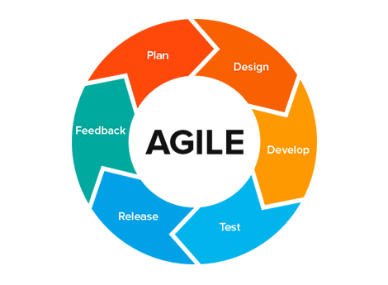
Agile model IN WEB ENG
Agile Model is an iterative and flexible SDLC approach where development is done in small increments called iterations or sprints.
Advantages:
Handles changing requirements easily
Faster delivery of working features
Continuous improvement
Disadvantages:
Requires active customer involvement
Less documentation compared to Waterfall
Can be difficult to manage without proper discipline

Slide 17
Principles of Web Engineering
The basic principles of Web Engineering can, however, be described similarly to those of Software Engineering (cf. e.g. Lowe 1999, Selmi 2005):
1) Clearly defined goals and requirements
2) Systematic development of a Web application in phases
3) Careful planning of these phases
4) Continuous audit of the entire development process.

Slide 18
Web-based approach VS traditional approach
Web-based approach | Traditional approach
It uses ad hoc costing of work that is based on the inputs from users. | Stronger cost estimations are needed and that in turn require a lot of experience.
There is no standard on the size measure of Web applications. | It uses either line of code (LOC) measure or function points (FP) measure for size estimations.
Effort estimation is done using a bottom-up approach based on the user’s inputs. | Effort estimations are done using equations like COCOMO equations.

Slide 19
Web-based approach VS traditional approach
Feature | Traditional Approach | Web-based Approach
Requirements | Fixed | Frequently changing
Development | One time | Continuous
Deployment | Version based | Continuous updates
Maintenance | Low | High
User Access | Limited users | Millions of users
Platform | Mostly Desktop | Browser + Internet
Flexibility | Less | High
Technology | Standalone software | Web technologies

Slide 20
Web-based approach | Traditional approach
Not much historical data is available from the past projects. | Historical data from the previous projects is also available.
Quality is difficult to measure as newer methods are needed for Web-like projects. | Quality is measurable using known quality measures like defect rates, system properties, etc.
It involves many different components like fine-grained, interpreted scripting languages, commercial off-the-shelf (COTS), multimedia files, HTML, XML, databases, distributed applications, navigational models, etc. | It involves integration of different components like COTS, databases, images, etc.
The development process drivers are reliability, usability and security. | The basic process driver is time to market.

Slide 21
Defining Web Applications
A Web application is a system that utilizes W3C standards & technologies to deliver Web-specific resources to clients (typically) through a browser.
Web resources are virtual files that are stored in the database and that you can retrieve by using a unique URL address.
Technology + interaction.
Notes:
Difference between Web site and a Web application lie in the point of reference.
A Web site is actually different from a Web application. A Web site generally consists of static pages only.
On the other hand, a Web application comprises both static pages and dynamic pages usually, a back end like rational database management system (RDBMS)].

Slide 22
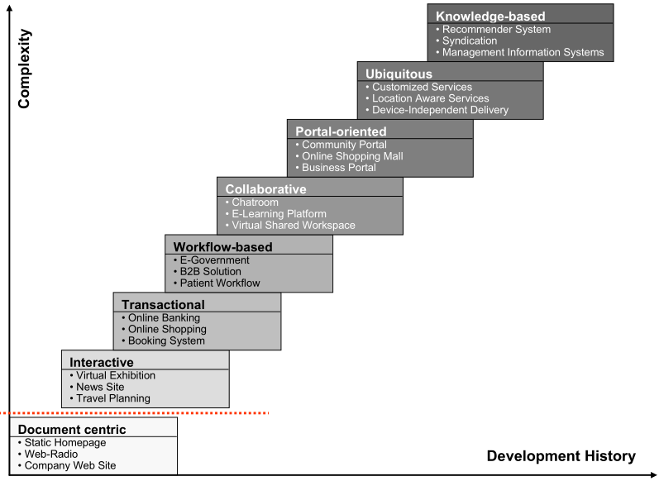
Categories of Web Applications
Kappel, G., Proll, B. Reich, S. & Retschitzegger, W. (2006). Web Engineering, Wiley & Sons

Slide 23
Categories of Web Applications (Based on Functionality)
Functionality/Category | Examples
Informational | Newspapers on net, manuals, reports, product catalogues, online books
Interactive | Registration forms, online games, customized information presentation
Transactional | Online shopping, online banking, online airline reservation, online bill payments
Workflow oriented | Online planning and scheduling, inventory management, business-to-business (B2B) solutions in e-commerce, status monitoring, software configuration management (SCM)

Slide 24
Contd…
Functionality/Category | Examples
Collaborative work environments | Distributed authoring systems, collaborative design tools
Online communal societies, marketplaces | Discussion groups, online marketplaces, e-mail, recommender systems

Slide 25
CHARACTERISTICS OF WEB APPLICATIONS
The characteristics of Web-based projects are based on ISO 9126 model of software quality only. They are put under three main categories as follows:
1. Product-related characteristics;
2. Usage-related characteristics; and
3. Development-related characteristics.

Slide 26
Product-related Characteristics
These characteristics include the content on a Website, its navigational model (hyperlink model) and the presentation [the graphical user interface (GUI)].
These characteristics are the major building blocks of a Web application.
1. Content
2. Hypertext (links pages )
3. Presentation

Slide 27
Usage-related Characteristics
The usage of Web application is complex, as it is very heterogeneous type where different mix of users work, different resources are used and the time and place of the Web application to be used cannot be easily determined. It includes the following three things:
1.Social context(student,teacher admin )
2.Technical context(Mobile, laptop, Chrome, Safari)
3. Natural context(Different places and ) times

Slide 28
Development-related Characteristics
It includes the following four main things:
1. Development teams
2. Technical infrastructure(Servers, frameworks, tools)
3. Development process(SDLC)
4. Required integration of already existing solutions(Payment gateway, Google Maps API)

Slide 29
summary
Traditional or conventional software evolution needs a well-planned series of versions while Web applications are developed continuously. This means that Web applications are in permanent maintenance phase. Web development needs a better requirements analysis in comparison to a traditional SDLC. This is because of the continuously changing nature of Web requirements. Web applications change rapidly. This constant change of requirements of a Web application is the core characteristic of Web applications. Changes may be in the product, its usage and its development.

Slide 30
Discussion
“Web engineering may not be a silver bullet.” Explain.
List some of the cyber losses that have resulted in loss of millions of dollars worldwide.
Distinguish between a Web site and a Web application.
What are the three main good-quality characteristics of Web according to you?

